Slide 1






CLOUD-BASED
NOTE SHARING PLATFORM
Guide name: Prof. Manoj Patil
Group members:
1. Atharva Kolhe
2. Rutuja Kerkar
3. Abinaya Kaunder
Enhancing collaboration and organization in online learning environments

Slide 2


Identifying Challenges in Academic Materials
Management
Unorganised materials lead to frustration and lost time for students.
Limited collaboration hampers
effective study groups and peer support.
Inefficient communication affects timely
updates about assignments and exams.
Exam periods reveal a critical need for
structured resources and accessibility.
To conduct secure online tests with MCQ and written answers.
To enable group chat for student
discussion and collaboration.

Slide 3


Objectives
A comprehensive solution to enhance academic collaboration through efficient note sharing and management for students and teachers alike.
Centralized Storage
Users can upload, access, and manage all their academic materials in one secure location, simplifying the study process.
Enhanced Collaboration
The platform fosters teamwork by enabling students to share notes and communicate effectively, especially during exam preparations.
User-Friendly Design
An intuitive interface ensures seamless navigation, making it easy for all students to engage with the platform's resources.

Slide 4
Objectives
A comprehensive solution to enhance academic collaboration through efficient note sharing and management for students and teachers alike.
Secure Online Test Module
Conduct MCQ and descriptive exams in a secure single-window environment to maintain exam integrity.
Group Communication
To support group-based chat for student discussion and collaborative learning.
Subject-Based Exam Preparation
To allow students to select a subject before exams and instantly access all related notes for focused and efficient revision.

Slide 5
Key Features of the Platform
Automated FAQ
Generation
The platform will use machine learning algorithms to create FAQs from previously asked questions, helping students find answers quickly and efficiently, especially during exam preparations.
Voice-Based Discussion forums
The platform functions as a voice-based discussion forum, similar to a Discord server, where teachers and students can interact in their dedicated groups.
Built-In Collaboration Tools
Integrated communication tools enable real-time collaboration among students and teachers, ensuring that everyone stays informed and engaged through announcements and discussion threads.
PDF Annotation Features
Students can annotate PDFs directly within the platform, allowing for interactive learning by highlighting important information and adding notes to lecture materials for enhanced understanding.

Slide 6
Key Features of the Platform
Secure Online Test Module
The system allows teachers to conduct secure online exams with both MCQ and descriptive questions. Tests run in a single-window environment, and any window change helps prevent malpractice
Attempt Control & Access Management
Students are limited to three test attempts. Once the test window is closed, reattempts are restricted and can only be granted with teacher approval, ensuring controlled and fair assessment.
Group Chat System
The platform provides group chat spaces where students can communicate, clarify doubts, and collaborate with peers in real time.
Subject-Based Exam Revision
Displays subject-wise notes when a student selects a subject before an exam, enabling quick and focused preparation.

Slide 7
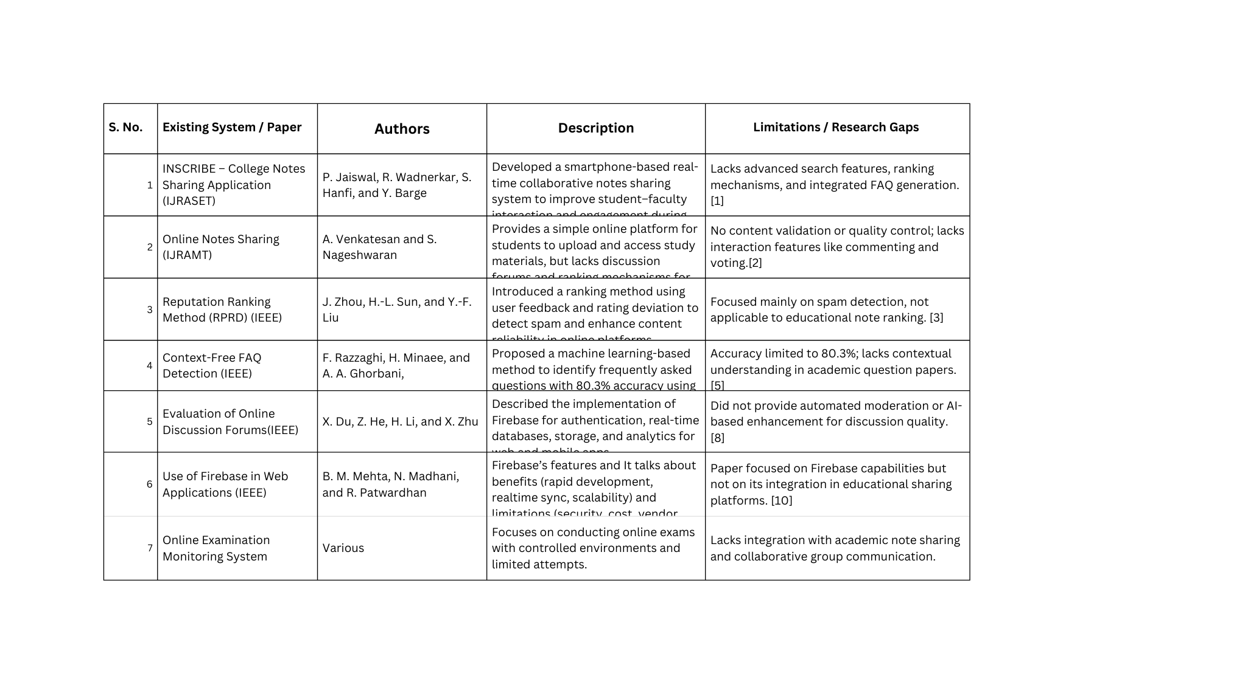
Literature review

Slide 8
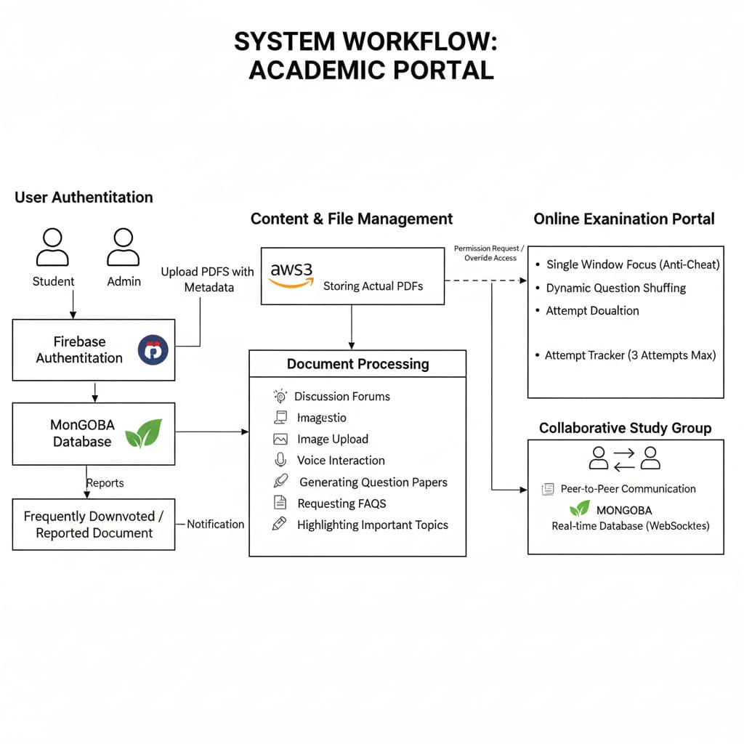

System workflow
This section explores the streamlined workflow of uploading, managing, and accessing notes ensures enhanced academic collaboration.

Slide 9
Essential Technologies for Our Platform
This section explores the key technologies that power our cloud-based note sharing and management platform for enhanced academic collaboration..
Frontend Framework
We utilize ReactJS to create a dynamic and responsive user interface, ensuring a seamless experience for all users.
State Management
Redux is implemented for efficient state management, allowing users to maintain consistent data across the application effortlessly.
Backend Technologies
Flask (Python) handles APIs and logic, MongoDB stores user and exam data, and AWS Cloud Storage securely manages documents.

Slide 10
Essential Technologies for Our Platform
This section explores the key technologies that power our cloud-based note sharing and management platform for enhanced academic collaboration..
Real-Time Communication
Group chat and live updates are powered by Firebase Realtime Database, enabling instant message synchronization among students.
Online Examination Control
Secure online exams run in a single-window mode with a maximum of three attempts. The system detects window switching and uses backend validation to prevent malpractice.
Authentication & Access Security
Role-based authentication and access control ensure that only authorized students and teachers can access exams and protected features.

Slide 11
Conclusion
Developing an academic notes sharing platform is expected to foster collaboration, improve knowledge sharing, and help students succeed.
Fosters collaboration
The platform is intended to encourage students to collaborate by sharing their academic notes and resources as the project progresses.
Projected Knowledge Sharing
It is expected that centralizing study materials will make knowledge sharing easier among students, providing equal access once the platform is built.
Potential for Improved Accessibility
The completed application aims to simplify how students find and use notes, making academic resources more accessible and organized in future.
Opportunities for Skill Development
The ongoing development is giving team members chances to learn and apply skills in web technologies, especially React.js and Firebase, which will contribute to personal growth.

Slide 12
Conclusion
Developing an academic notes sharing platform is expected to foster collaboration, improve knowledge sharing, and help students succeed.
Improved Student Interaction
Group chat functionality enables students to communicate, share ideas, and collaborate effectively in an academic environment.
Secure and Controlled Access
The platform ensures security through role-based authentication, controlled exam access, and teacher-managed permissions, preventing unauthorized usage and maintaining data integrity.
Enhanced Academic Evaluation
Secure online MCQ and descriptive exams are conducted in a single-window mode with a maximum of three attempts, ensuring fairness and exam integrity.
Comprehensive Learning Platform
The platform integrates secure exams, subject-wise revision, centralized storage, and real-time communication for effective academic management.

Slide 13
References
INSCRIBE – College Notes Sharing ApplicationP. Jaiswal, R. Wadnerkar, S. Hanfi, Prof. Yamini Barge; IJRASET, Nov 2021A platform for seamless college notes sharing, organized by course, with peer ratings to improve collaboration.
Online Notes Sharing - A. Venkatesan & S. Nageshwaran; IJRAMT, Apr 2022Web/mobile solution for sharing, categorizing, and rating notes to help standardize academic resources.
A Reputation Ranking Method based on Rating Patterns and Rating Deviation - Zhou, Sun & Liu; IEEE DSIT, 2022Introduces RPRD for accurately ranking users based on rating patterns to reduce spam in sharing systems.
Use of Discussion Forums in Online Learning Environments - Kilinc & Altınpulluk; 2021Analyzes how discussion forums promote engagement and knowledge sharing in online education.
ContextFree FAQ Detection Using Machine Learning - F. Razzaghi, H. Minaee & A. Ghorbani; IEEE/WIC/ACM WI, 2016Proposes a machine learning approach for identifying FAQs and supporting digital learning platforms.
Use of Firebase in Web Applications -B. M. Mehta, N. Madhani, and R. Patwardhan, Firebase’s features and It talks about benefits
(rapid development, realtime sync, scalability) and limitations (security, cost, vendor lock‑in).

Slide 14
THANK YOU FOR YOUR ATTENTION!

